Slide 1
Desktop photography and video editing
DIT 506
Videos

Slide 2
Videos
A video is a recording of a motion picture or objects at motion.
Example of a video: Performance of a song or script that aims at interpreting the meaning of word spoken or the lyrics of a song.
Video production: Process of making videos content. Earlier it was known as filmmaking because video was recorded of film stock.
Currently, videos are recorded digitally instead of on film stock.
Stages of video production
Almost all the videos undergoes the following main stages of production.
Pre-production
Principal photography (production),
Post-production.
Marketing and distribution

Slide 3
Pre-production
There are a lot of preperations during video pre-production for a successful video shooting.
These activities begins with a discussion with the clints for the content development.
in this phase, the client is asked to provide information like
The reason for a video
The intended audience
The anticipated action to be taken by viewers
The marketing and distribution plan
Using information provided by the client, a package that includes the idea, plan, timeline and budget is developed and approved by the client.
Writing of script, creation of storyboards, preparing a production schedule, auditioning talent and preparing the cast, hiring and preparing a crew, securing equipment, finding and securing locations, selecting wardrobes are all done in this phase. (All activities that needed for preparation of a successful video shoot)

Slide 4
Principal photography (production)
The main task of production process is the principle photography. This phase entails capturing the project assets using cameras to create animations.
Here is where all the time and energy spent preparing to reach the highest level of development with the aim of coming up with something special.

Slide 5
Post-production.
The captured videos are edited, music, audio effects and voiceover are added to the videos where necessary.
Some adjustment to sound and colour, adding titles and creating special effects.
Creation of publicity materials
Releasing the project for target audience.

Slide 6
Marketing and distribution
Once the project is complete and out, the next phase is for audience to watch it.
In this phase, focus is shifted and more effort put to marketing and distribution done according the drafted plan.

Slide 7
Discussion
What are some of your favorite TV shows?
How much planning do you think goes into creating a TV them?

Slide 8

The Production Model
Effect to Cause Model: once you have developed the initial idea, you move directly to what, ideally, you want the viewers to learn, feel, or do.
This is known as the process message.
The production model suggests that rather than move from the initial idea to the production, you jump from the initial idea to a program objective (the desired effect on the viewer).
Then and only then do you back up and decide on the medium requirements necessary to produce the intended communication effect.
Medium Requirements: re-expressed as workflow that includes selecting talent, determining technical and nontechnical personnel, and requesting studio or field facilities and equipment.

Slide 9
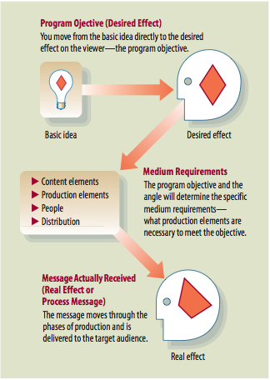
The Production Model

Slide 10
Three Phases of Production (model based)
Preproduction: The preparation of all production details.
  Stage 1: all activities necessary to transform the basic idea into a workable concept or script -This is where you can brainstorm or cluster ideas with your crew/group.
  Stage 2: production details such as location, crews, and the necessary equipment.
Production: The actual activities in which an event is recorded and /or televised.
  It includes all activities in which an event is video-recorded or televised.
Postproduction: Any production activity that occurs after the production. Usually refers to either video editing or audio sweetening (a variety of quality adjustments of recorded sound).
  Video & audio editing.
  Color correction.
  Background music selection
  Special effects

Slide 11
Preproduction: From Idea to Script
Program Objective: Exactly what is it that you want the audience to know, feel, or do.
Angle: an angle is a specific approach to the story. A point of view of the event. Effective video programs often have an angle that is different from the usual treatment of the same subject and is more relevant to the viewer.
Evaluating Ideas
Is the idea worth doing? It should have a positive influence on someone's life.
Is the idea doable? Do you have or can you get all medium requirements?
If the answer to both these questions is maybe, then don’t go any further.

Slide 12
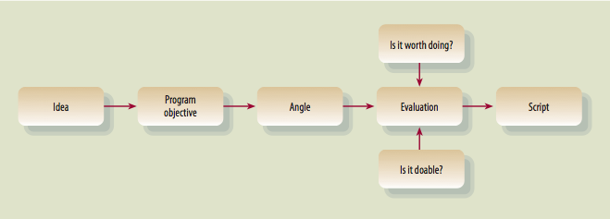
Preproduction: From Idea to Script

Slide 13
Program Proposal
Program Proposal
A program proposal is a written document that stipulates what you intend to do. It includes the following:
  Program Series or Title
  Program Objective: “the process message is to…..”
  Target Audience: whom you would primarily like to have watch the show- the elderly, preschoolers etc.
    You can define the target audience further in terms of demographics – such as gender, ethnicity, education income, household size, religion and geographical & location.
  Show Format: Is it a series? How long does it run? Is it a 1 hour special? Is it a commercial?
  Show treatment: A brief narrative description of the program. It should explain the angle & plot fully.
  Production method: single or multi camera set-up? Single camera film-style? Studio production …etc.
  Tentative Budget: How much do you estimate this will cost?

Slide 14
Zettl Text Book - 11th Edition
Please look for this books to Page 30 in the text.
Read the sample “Show Treatment” and answer the following questions:
  What is the Program Objective?
  Who do you believe is the target audience?
  What is the show format?
  What is the production method?

Slide 15
Creating your own Proposal
You will write a project proposal for a commercial or short special about any topic.
Use the blank project proposal sheet. You will need all of the following information filled out completely.
    Program series or title (even commercials have titles!)
    Your objective
    Target audience
    Show format
    Show treatment

Slide 16
Production People
Nontechnical Production Personnel (above-the-line-personnel)
  Generally involved in translating a script or an event into effective television image: Executive Producer, Producer, Associate Producer, Production manager, production Assistant, Director, Associate Director, Floor Manager & people.
Technical Production Personnel (below-the-line-personnel)
  Consists of people who are primarily concerned with operating equipment: camera operators, audio and lighting people, video recording operators, video editors, and people who set up communication and signal transmission.
You should realize, however, that in smaller television and film operations, one person might carry out several different functions.
  For example the producer may also write and direct the film/show.

Slide 17
Production Team: Who Does What When?
The preproduction team is comprised of the people who plan the production. Normally includes the producer, writer, director, art director, and technical director. Large productions may include a composer and a choreographer. In charge: producer.
The production team comprises the people who translate idea into actual video pictures and sound.
  The production team comprises a variety of nontechnical and technical people, such as producer and various assistants (associate producer and production assistant), director and assistant director, and talent and production crew. In charge: director.
The postproduction people put together all selected clips, which contain the optimal video and audio segments, and give the whole production the final polish.
Normally consists of the director, a video editor, and, for complex productions, a sound designer who remixes the sound track.

Slide 18
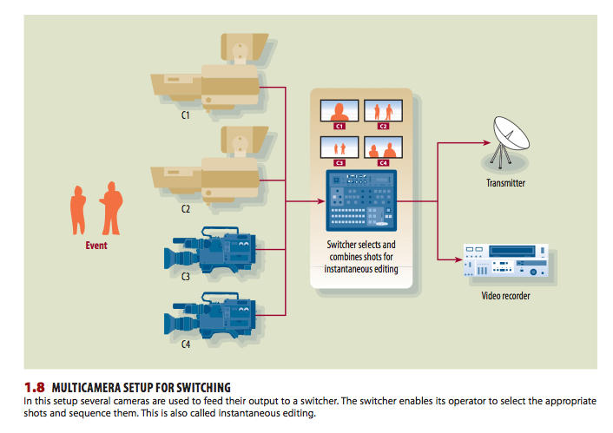
Technical Production Systems
The television system consists of equipment and people who operate that equipment for the production of specific programs.
Multi-camera Studio Systems uses two or more cameras, camera control units(CCUs), preview monitors, switcher, a line monitor, one or more video recorders, and a line-out that transports the video signal to he recorder and/or transmission device.

Slide 19

Studio Production
The production crew usually includes the following:
  floor manager and floor persons (grips or utility persons)
  technical director
  camera operators
  lighting director (LD)
  video operator (VO)
  audio engineer
  video-record operator
  C.G. (character generator) operator.
  Director
  Producer
  Assistants
The production schedule, compiled by the producer, is the overall calendar for a production, which can span weeks.
The time line, on the other hand, is usually drawn up by the director and shows the allotted time segments for a single production day.

Slide 20
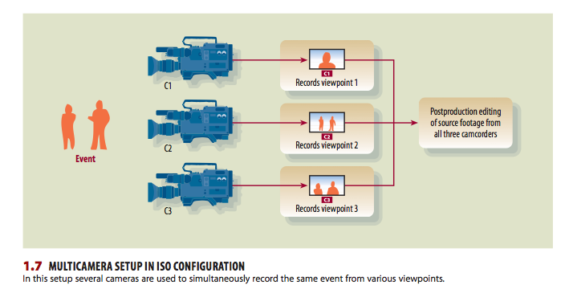
Technical Production Systems
Field Production Systems
  ENG System - Electronic news gathering is usually done with a camcorder, which houses an entire video system. It contains al the elements needed to capture and record an event.
  EFP System - Electronic Field Production, Normally consists of a portable camcorder(s) to record various segments of an event for postproduction editing.

Slide 21
Other Production Teams
News Production Personnel
  News director – In charge of all news operations.
  Producer – Responsible for the selection & placement of the stories in a newscast.
  Assignment Editor – Assigns reporters and videographers to specific events to be covered.
  Reporter - Gathers the stories. Often reports on camera in the field.
  Videographer – Camcorder operator.
  Video editor – edits video according to reporter notes or script.
  Anchor – Principal presenter of the news, usually in the studio.
  Weathercaster, traffic reporter & sportscaster.
Electronic News Gathering Team(ENG) for simple stories could be done by a single person, who simultaneously acts as reporter, camcorder operator, and editor/ narrator.
Even relatively simple electronic field productions (EFPs) are usually done with three people. The EFP team consists of talent, camcorder operator, and a utility person who takes care of the lighting, audio, and, if necessary, additional video-recording devices.

Slide 22





